Slide 1
Capstone Project Presentation by Group 3
Washington-DC-Crime-Analysis

Slide 2

Agenda
Introduction
Statement of the Problem
The Challenge
Data Cleaning Steps
Key Performance Indicators
Summary of Findings
Conclusion

Slide 3
Introduction A Power BI crime data analysis project for Washington, D.C., uncovering trends, hotspots, and severity to support data-driven decisions. Includes key KPIs like Crime Severity Index, Top 5 Crime Types, and Time of Day insights to guide targeted policing and community safety efforts Problem Statement Washington, D.C. faces ongoing challenges related to crime and public safety. Addressing these effectively requires deep, data-driven insights into how crime unfolds across time and space. The Challenge Using Power BI, this project explores a comprehensive crime dataset to reveal patterns and correlations that can guide decision-making and strategic planning for crime reduction Data Cleaning Steps Ensured columns are in the correct data type Filtered out null values Dropped unnecessary columns Dataset Source → Onyx Data March 2025 Challenge

Slide 4
Key Performance Indicators
Total Crimes Reported – Volume of crimes over the selected timeframe
Crimes by Time of Day – Shift-based crime distribution (Midnight, Day, Evening)
Top 5 Crime Types – Most frequent offense categories
Crime Severity Index – Weighted metric using UCR crime rankings
Crime by Neighborhood – Crime counts by neighborhood cluster
Hotspot Analysis – Geographic crime concentration visualized
Weapon-Related Crimes – Percentage involving firearms!
Trends Over Time – Monthly and yearly crime trend tracking

Slide 5
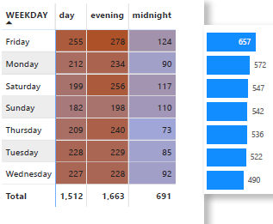
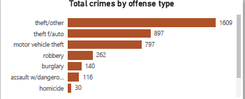
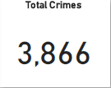
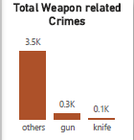
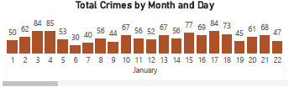
Total Crimes Reported
Top 5 Crime Types -Theft/Other: 1,609, Theft (Auto): 867,Motor Vehicle Theft: 797,Robbery: 262,Burglary: 140
Friday has the highest number of crimes reported which is 657 and its mostly in the evening while Wednesday has the list number of cases reported
Weapon-Related Crimes
-Gun: 3.5k
-Knife: 0.3k
-Other: 0.1k
Daily crime trends in January:
Range: ~47 to 68 crimes per day.
Peak: January 5th with 68 crimes.

Slide 6
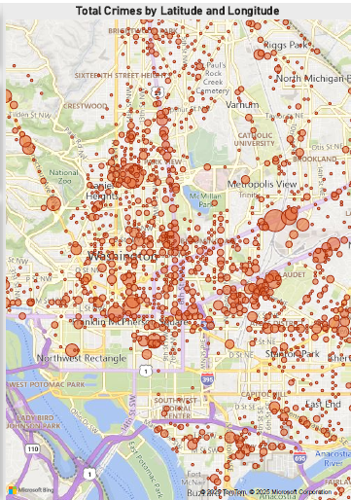
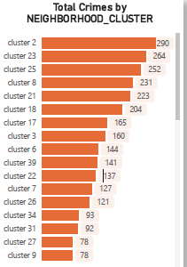
Crime by Neighborhood -Top clusters by total crimes
-Cluster 23: 260
-Cluster 28: 245
-Cluster 24: 231
-Cluster 30: 226
-Cluster 25: 216
Hotspot analysis shows crime concentration in central/northeast DC, with larger red circles indicating higher crime density.

Slide 7
Conclusion
The Washington DC Crime Analysis reveals a total of 3,866 reported crimes, with the highest frequency occurring during the evening hours, particularly on Fridays. The most common crime type is theft/other, followed by auto theft and motor vehicle theft, indicating a strong trend in property-related offenses.
Crime distribution is heavily concentrated in certain neighborhood clusters such as Cluster 23, 28, and 24, highlighting specific hotspots that require targeted interventions. Geospatial visualization confirms dense crime activity in central and northeast DC, aligning with high-incidence census tracts
Weapon-related crimes, particularly those involving firearms, account for a significant portion of offenses, which is a pressing public safety concern. The Crime Severity Index shows a considerable number of high-impact crimes, emphasizing the need for law enforcement focus in high-risk areas.
In summary, the findings underscore the importance of strategic resource allocation, community policing, and preventive measures in high-crime zones, especially during peak times and in neighborhoods with consistent high crime rates.

Slide 8
Credits to
George Mwaura- Group Leader
Naijeria Toweett
Maureen Orwa
Stella Kabue

Slide 9

Thank you!!

